Slide 1

Session 5: UI/UX Design
Introduction to Software Engineering

Slide 2

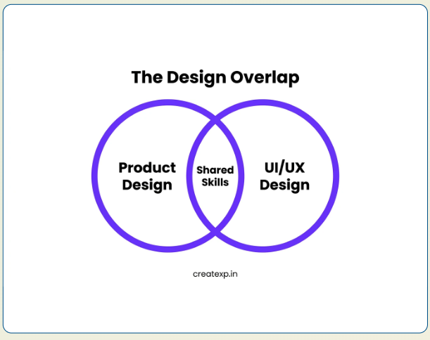
Role of UI/UX in Software Quality
User Perspective: Users judge system quality based on their interaction experience, not internal code.
System Success: A poor interface is the leading cause for systems being discarded by users.
Error Prevention: Effective UI design minimizes catastrophic human errors in critical systems.
Operational Value: Enhances productivity by aligning software behavior with human cognitive limits.
Industry Case: The 1993 Warsaw plane crash was partially attributed to an interface not clearly communicating system assumptions during landing.

Slide 3

Defining UI and UX Concepts
User Interface (UI)
User Experience (UX)
Focuses on the visual elements of the product
Includes layouts, colors, fonts, and interaction buttons.
The bridge between humans and digital circuits.
Goal: Visual appeal and technical clarity.
The overall feeling of the interaction process.
Focuses on task flows, ease of use, and emotional satisfaction.
Holistic journey from startup to task completion.
Goal: Effectiveness and user delight.
Impact on Costs: Proper UI/UX design during early process phases significantly decreases late-stage code modification and testing rework.

Slide 4
Part 1: UI/UX Design Pipeline

Slide 5
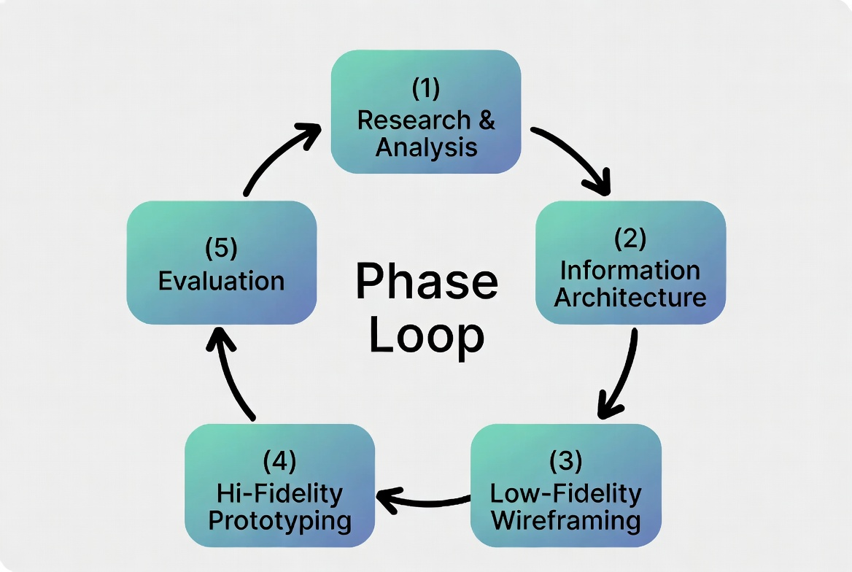
The Iterative UI/UX Design Pipeline
Iterative Nature: Design is never "one and done." It cycles through feedback.
Human-Centered: Design revolves around user needs, not developer convenience.
Consistency: The process ensures logic is carried from abstract to concrete.
Framework: The "Double Diamond" model separates divergent thinking (discovery) from convergent implementation.

Slide 6

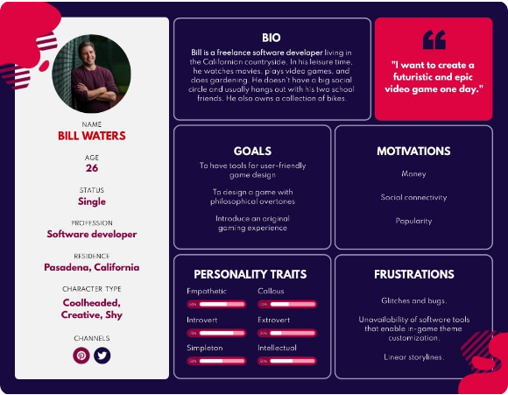
Phase 1: User Research & Analysis
Understand user roles, workflow tasks, and environmental constraints.
User Profiles: Based on requirements, identify who will use the system (Persona Development).
Task Analysis: Based on Use case Specs, Activity Diagram, understand the sequence of actions to reach a goal.
Environment: Design for Web/Mobile/Specific device
Requirements: Distinguish between "must have" and "nice to have" UI features.
Technique: "Shadowing" involves watching users work in their actual environment to find pain points.

Slide 7
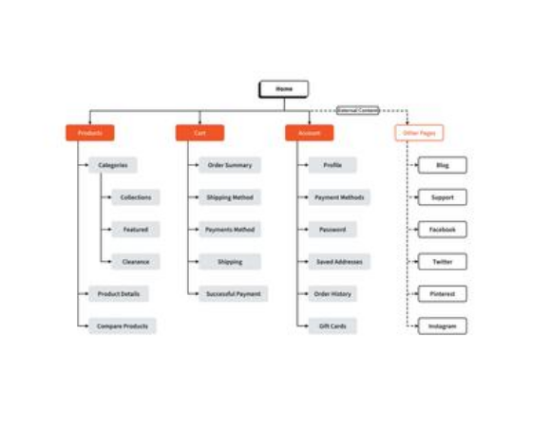
Phase 2: Information Architecture
Hierarchy: Organising information so users know where to find what they need.
Navigation: Designing menus, sitemaps, and search pathways.
Grouping: Sorting functions by object (Patient, Doctor) or by task (Report, Search) or by business (sale, marketing, …).
Sitemap: A visual map showing the structure of all screens.
Technique: "Card Sorting" allows users to group functionality themselves to see what's logical.

Slide 8
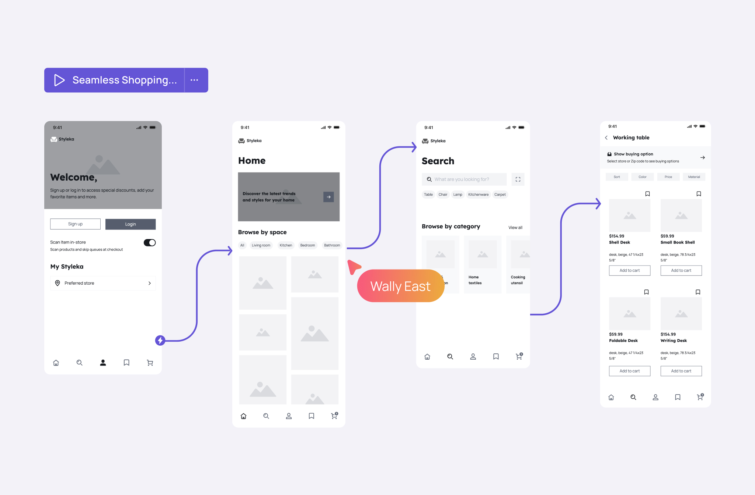
Phase 3: Low-Fidelity Wireframing
Translate structural abstract models into physical screen layouts.
Sketching: Quick, hand-drawn paper designs to explore layout options.
Focus: Content placement and functionality, NOT aesthetics or colors.
Speed: Allows for rapid iteration and discarding of bad ideas early.
Feedback: Best for getting user feedback on structure without distractions.
Tools: Often performed using pen and paper, whiteboards, or digital wireframing tools (Balsamiq, Miro)
SE Mindset: Spending 1 hour on paper sketches can save 100 hours of coding the wrong thing.

Slide 9
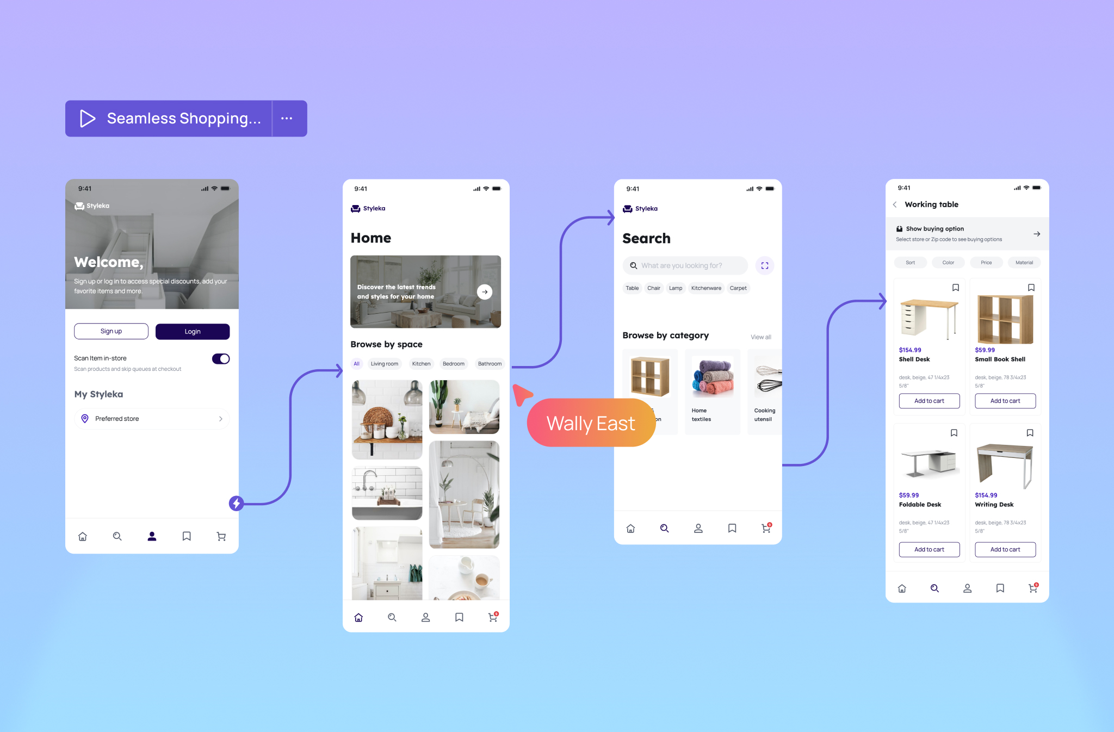
Phase 4: High-Fidelity Prototyping
Build executable or interactive simulations to evaluate against user expectations.
Mockups: Digital designs that look exactly like the final product.
Interactive: Buttons and links actually work to simulate the task flow.
Stakeholder Buy-in: Best for showing management or clients exactly what they will get.
Handoff: Serves as the blueprint for the development team.
Industry Standards: Primarily developed using specialized design systems in Figma or Adobe XD
Industry Case: High-fi prototypes are often mistaken for the real app, proving their effectiveness for testing.

Slide 10
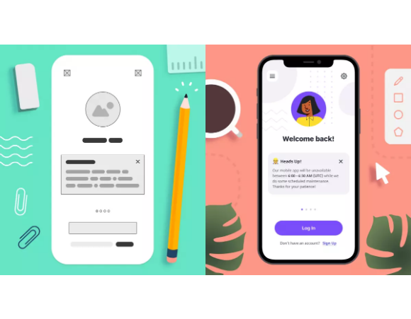
Transition: Low-Fi vs. High-Fi
•
Evolution: Sketch (Ideation) → Wireframe (Structure) → Prototype (Simulation).
Level of Detail: Low-fi is abstract; High-fi is concrete.
Cost: Low-fi is cheap; High-fi requires specialized tools and time.
Interactivity: Moving from static images to dynamic, clickable screens.
Industry Rule: Never start high-fi before the low-fi logic is agreed upon to avoid expensive rework.

Slide 11
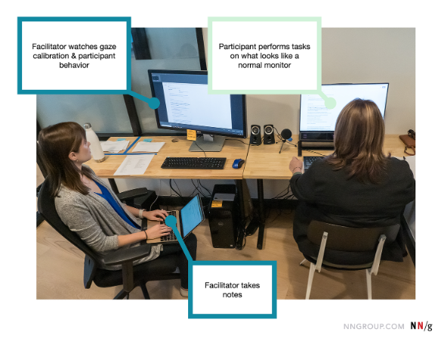
Phase 5: Evaluating UI: Methods & Metrics
Continuous Feedback: The outputs of usability testing constantly trigger refactoring of the user requirements and architectural models.
Heuristic Evaluation: Fast and low-cost check by UI experts.
Usability Testing: Watching real users perform tasks to find friction.
Cognitive Walkthrough: Simulating a user's first-time experience.
A/B Testing: Comparing two versions to see which performs better.
Golden Rule: Test early and test often. Problems found during design are cheap to fix.

Slide 12
Part 2: Design Principles & Jakob Nielsen's Heuristics

Slide 13
Core UI Design Principles
Usability: The ease with which users can learn to operate the system and achieve their operational goals.
Accessibility: Designing interfaces inclusive of users with visual, auditory, cognitive, or physical impairments (e.g., meeting WCAG color contrast standards).
Consistency: Utilizing identical command structures, menu locations, icons, and messaging layouts across all modules to reduce learning curves.
Efficiency & Performance: Minimizing user effort (mouse clicks, keystrokes) to complete repetitive task workflows.
Core Philosophy: A professional user interface should remain invisible; users must focus completely on completing their real-world task, not on navigating the software mechanics.

Slide 14
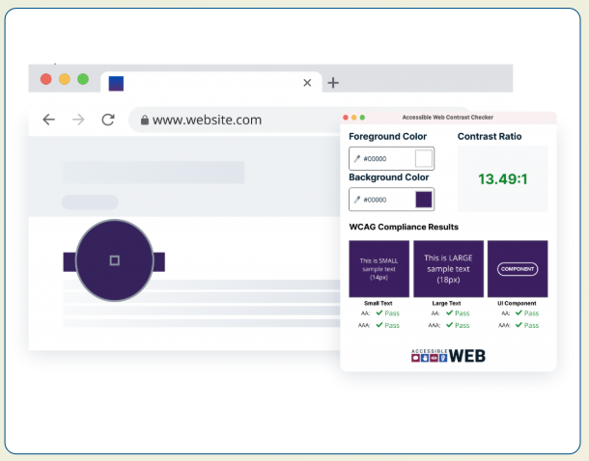
Usability: The Core Quality Pillar
•
Learnability: Time required for a user to learn the system functions.
•
Operability: Features that make it easy to control and navigate.
•
User Error Protection: Preventing user mistakes before they occur.
•
Inclusivity/Accessibility: Usable by people with a wide range of capabilities.
•
Appropriateness: How well the UI fits the context of use.
Industry Case: Amazon's "1-Click" ordering is a classic example of maximizing operability and user engagement.

Slide 15
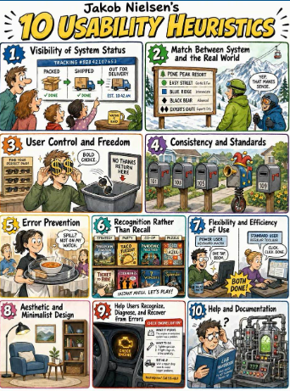
Jakob Nielsen’s 10 Heuristics
Foundational "rules of thumb" for usable interface design.
Developed by Nielsen and Molich in 1990.
Used to evaluate systems quickly without formal user testing.
Focused on cognitive science and human-computer interaction (HCI).
Method: "Heuristic Evaluation" involves experts checking the UI against these 10 benchmarks.

Slide 16
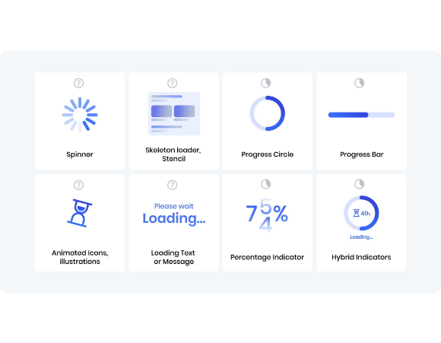
H1: Visibility of System Status
•
Definition: The system should always keep users informed about what is going on.
•
Feedback: Provide appropriate feedback within a reasonable timeframe.
•
Components: Progress bars, loading spinners, and breadcrumbs.
•
Confidence: Reduces user anxiety by confirming the system received the input.
Industry Example: Gmail shows "Sending message..." and then "Message sent" to confirm status.

Slide 17
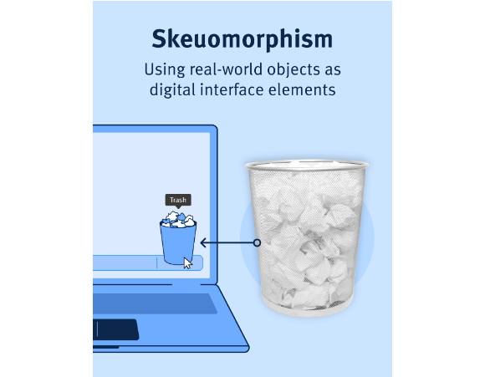
H2: Match System to Real World
•
Terminology: Use words and concepts familiar to the user, not internal system jargon.
•
Mental Models: Follow real-world conventions and logical order.
•
Metaphors: "Trash can" for deletion; "Folder" for storage.
•
Mapping: Controls should look like what they do (e.g., switches for on/off).
Bad Example: Showing error codes like "Exception 0x8004" instead of "File Not Found."

Slide 18

H3: User Control and Freedom
•
Emergency Exit: Users often perform actions by mistake; they need a clear way to leave unwanted states.
•
Undo/Redo: Support multi-level undo/redo to allow safe exploration.
•
Navigation: Always allow a way "Back" or "Home" without getting trapped in a wizard.
•
Autonomy: Give the user power over their own workflow.
Industry Example: MS Word's extensive undo history allows designers to experiment without fear of loss.

Slide 19

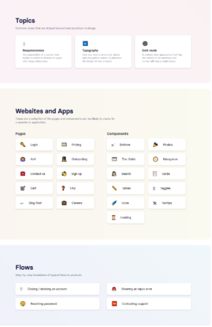
H4: Consistency and Standards
•
Internal Consistency: Same words/actions should mean the same thing within your app.
•
External Consistency: Follow platform and industry standards (Material Design, Apple HIG).
•
Layout Stability: Keep navigation and primary actions in consistent locations.
•
Predictability: Reduces the user's cognitive load and learning curve.
Industry Case: All major web browsers place the "Address Bar" at the very top for consistency.

Slide 20
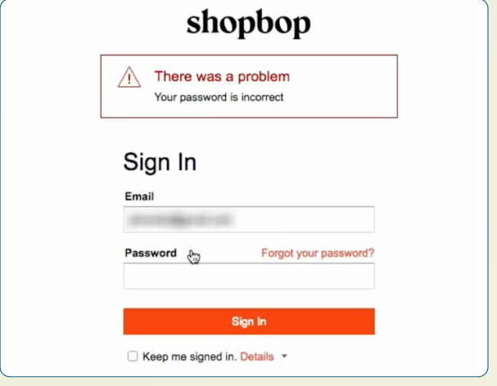
H5: Error Prevention Strategies
•
Slips vs. Mistakes: Prevent accidental clicks (slips) and mental misunderstandings (mistakes).
•
Confirmation: Ask for confirmation before high-impact or destructive actions (e.g., Delete).
•
Constraints: Disable invalid options (e.g., graying out unavailable dates).
•
Input Masks: Guide users into the correct data format (e.g., phone numbers).
Example: Google Search's "Did you mean..." prevents mistakes caused by typos.

Slide 21
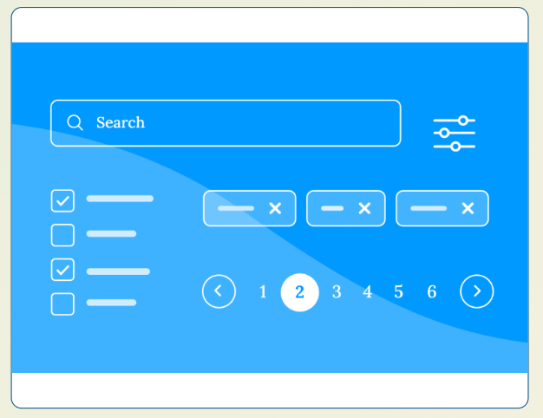
H6: Recognition rather than Recall
Memory Limits: Don't force users to remember information from one part of the app to another.
Visible Options: Make actions and choices visible so users can recognize them.
Search History: Show recent items to help users pick up where they left off.
Contextual Help: Provide instructions exactly where the action happens.
Industry Example: Netflix's "Continue Watching" row uses recognition to speed up the UX.

Slide 22
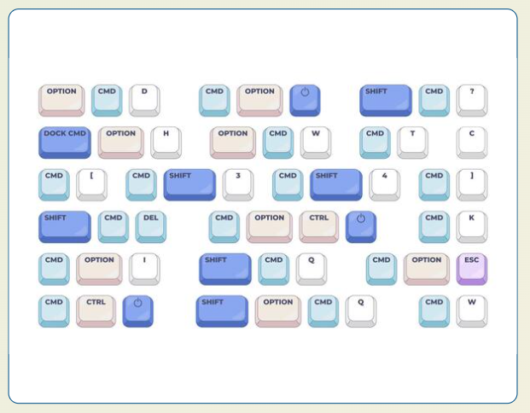
H7: Flexibility and Efficiency
Accelerators: Provide shortcuts (like Ctrl+C) hidden from novices but used by experts.
Customization: Allow users to tailor frequent actions or dashboard layouts.
Default Values: Prefill information based on sensible defaults to save user effort.
Batch Actions: Allow users to perform the same action on multiple items.
Example: Adobe Photoshop's customizable toolbar supports both beginners and veterans.

Slide 23
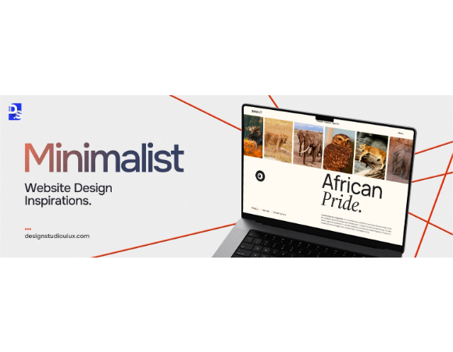
H8: Aesthetic & Minimalist Design
Signal vs. Noise: Every extra unit of information competes with relevant info.
Visual Hierarchy: Use size, color, and weight to draw attention to critical elements.
Whitespace: Use "negative space" to prevent clutter and group related items.
Essentials Only: Remove decorative elements that distract from primary tasks.
Industry Standard: Google's search homepage is the gold standard for minimalist functional design.

Slide 24
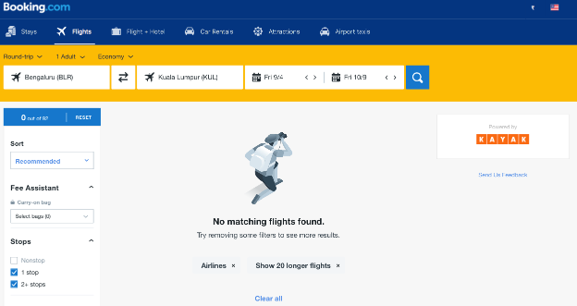
H9: Help with Error Recovery
Plain Language: Explain the problem without using scary system error codes.
Precise Indications: State exactly what went wrong (e.g., "Password must be 8+ chars").
Constructive Solutions: Suggest how the user can fix the error immediately.
No Blame: Don't make the usr feel like they "broke" the system.
Bad Example: "Database Error: -1004" | Good Example: "The server is busy. Please try again in 5 mins."

Slide 25
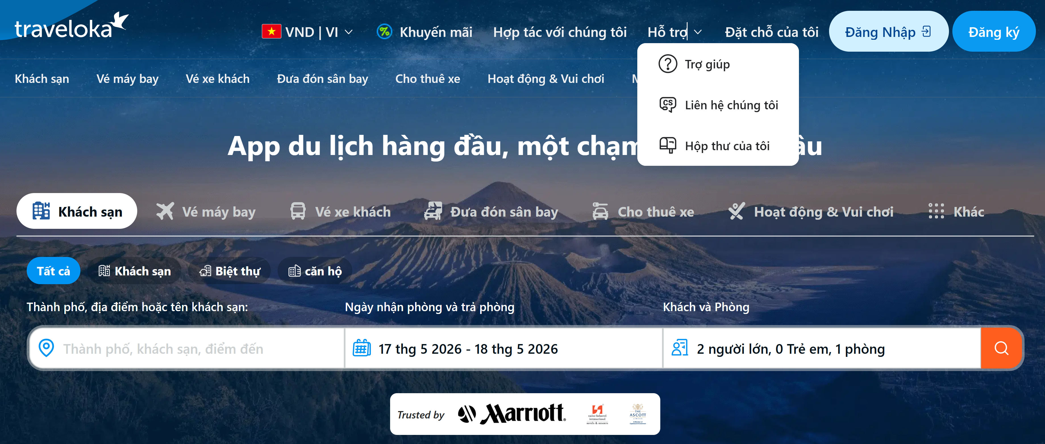
H10: Help and Documentation
Last Resort: Ideally the system is so intuitive it needs no help.
Searchable: Users should be able to find answers to specific tasks quickly.
Concrete Steps: Provide numbered steps to guide through complex operations.
Context-Sensitive: Tooltips and info icons provided at the point of action.
Industry Case: Slack's "Help Bot" provides instant, searchable context within the app interface.

Slide 26
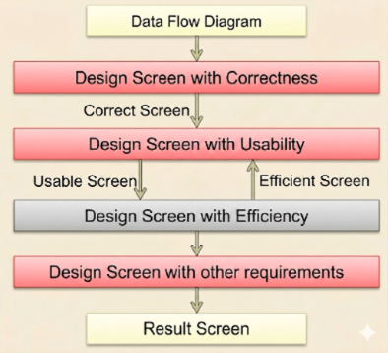
Part 3: UI Design for Quality Metrics

Slide 27

Step 1: Design for Correctness
OBJECTIVE
Ensure all business data requirements are present and functionally accurate.
Mapping: Cross-check screen fields against the Database Schema (ERD) and User Form.
Mandatory Data: Identify "Required" fields based on business rules.
Data Integrity: Ensure correct types (Number, String) are used for inputs.
Industry Rule: If a field exists in the DB but not on the screen, a business process is likely broken.

Slide 28
Step 2: Design for Usability
OBJECTIVE
Enhance user comfort through natural logical flow and familiar layouts.
Contextual Grouping: Cluster related fields together (e.g., Billing Address block).
Terminology: Use human language, not technical database field names.
Visual Hierarchy: Make primary actions (e.g., "Submit") stand out visually.
UX Tip: Grouping information reduces the time users spend scanning the screen for the next step.

Slide 29

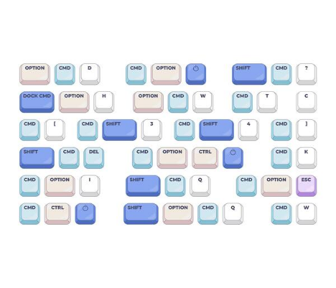
Step 3: Design for Efficiency
OBJECTIVE
Minimize user effort and maximize system performance throughput.
Default Values: Predict inputs based on most common user behavior.
Auto-focus: Place the cursor automatically in the first required field.
Shortcuts: Implement keyboard accelerators for experienced power users.
Batch Processing: Allow multiple data changes in a single action.
Example: Amazon saves card details (Default Values) to achieve "1-Click" shopping efficiency.

Slide 30
Part 2: UI Design Deliverables & Design Steps of Specific Screens

Slide 31
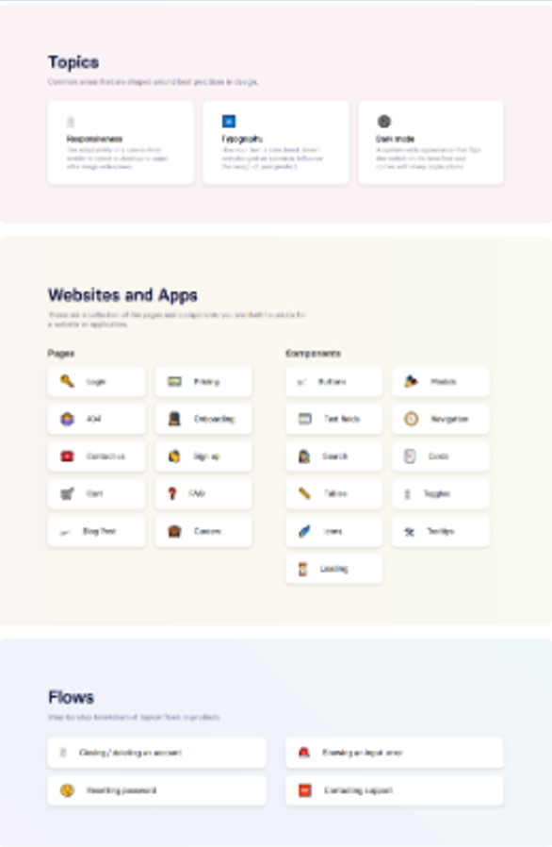
Deliverables of UI Design
Screen Map (Sitemap): Visualizes the hierarchy and navigation paths between all screens.
Detailed Screen Specification: Describes every data element, button, and logic for each individual screen.
Attribute Table: Defines data types, constraints, and sources for every field (e.g., Mandatory vs. Optional).
Interaction Logic: Maps user actions (clicks, swipes) to system responses (queries, messages).
Standard: Deliverables must be clear enough for a backend developer to build logic and a frontend developer to build the view.

Slide 32


Components of a Screen Specification
Input Data
Output Data
Control Elements
•
User text fields.
•
Calculated values.
•
Action Buttons (Save, Delete).
•
Selection boxes (Combo, List).
•
Database query results.
•
Navigation Links.
•
Date/Time pickers.
•
Status labels.
•
Hotkeys & Shortcuts.
Each component must be mapped to the Use case, Activity/Sequence Diagram, Class Diagram (session 3), Data Model (session 4).

Slide 33
Seven basic screen types
A user screen is a combined of some basic screen types below.
No. | Screen Type | Purpose | Content
1 | Main Screen | Allow users to select the task they want to perform | List of tasks
2 | Data Entry Screen | Allow users to create and save information generated in the real world | Information to be saved
3 | Data Processing Screen | Allow users to provide the information required to perform a specific task | Information that must be provided
4 | Search & Query Screen | Allow users to search for information that has already been stored | Search criteria
5 | Report Screen | Display reports summarized by a certain time period | Report templates
6 | Result Screen | Display the results of performing a specific task (search, processing, report, …) | Results
7 | Notification Screen | Notify and remind users of a process they need to perform | Notifications & feedback

Slide 34
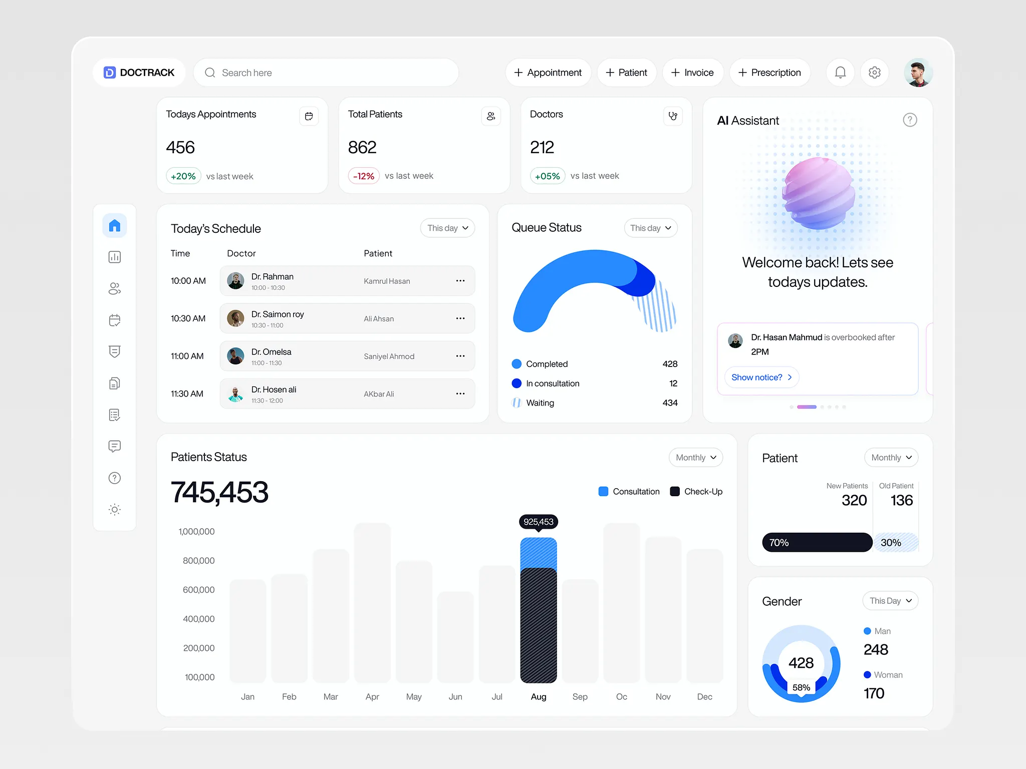
Main Screen
The entry point of an application that organizes access to all underlying sub-systems and business capabilities.
Purpose: Overview of current status and starting point for all tasks.
Efficiency: Highlight the most common or urgent functions.
Aesthetics: Balanced layout to prevent overwhelming the user.
Personalization: Show info relevant to the specific user role (Admin vs. Guest).
Example: A hospital dashboard showing "Urgent Lab Results" and "Today's Schedule."

Slide 35

Main Screen: Menu-Driven Style
Menu-Driven Structure
Iconic Interface
Diagrammatic Interface
Integrated Interface
Textual or hierarchical lists where related operations are structured into logical groups.
Commands and navigation pathways are represented entirely via visual, metaphoric images.
Displays an interactive flowchart or topology map representing major system objects.
Users trigger tasks by clicking components within the workflow.
A combination of multiple formats.
Typically utilizes a primary menu frame combined with real-time iconic or diagrammatic dashboards.

Slide 36
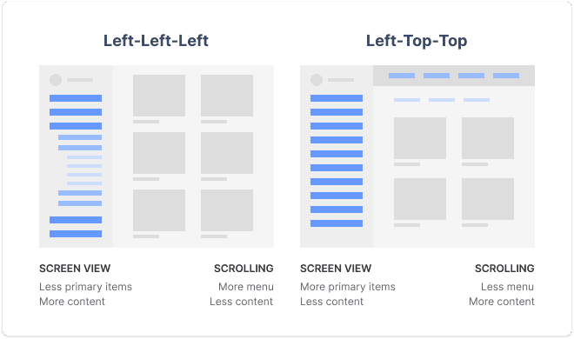
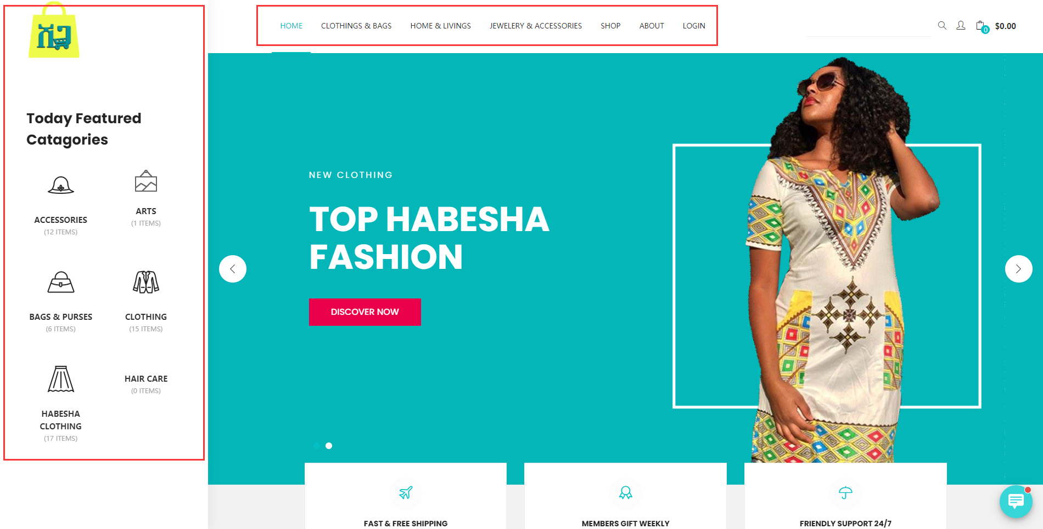
Main Screen: Menu-Driven Styles
Vertical Menus: Ideal for systems with many sub-categories (Sidebars).
Horizontal Menus: Best for high-level module navigation (Top bars).
Mega Menus: Used in complex systems like ERPs to show all options at once.
Drop-downs: Keep the interface clean while hiding deep functionality.
Industry Standard: Most modern Web Apps use a hybrid: Horizontal Top Bar + Vertical Sidebar.

Slide 37

Main Screen: Menu-Driven Style
Function-Oriented Menu
Object-Oriented Menu
Business Process-Oriented Menu
Grouped by system actions:
CRUD
Search
Report
Calculation
Administration
Grouped by critical domain entities, business entities or DB models:
Patient Management
Medication Records
Consultation History
Inventory Status
All storage, search, and reporting mechanisms for that entity are kept inside that single group
Arranged chronologically based on real-world steps of an industrial operation:
Organization
Planning
Ingestion/Reception
Execution/Operation
Synthesis/Summary

Slide 38
Main Screen: Menu-driven Style
No. | Menu Type | Purpose | Content
1 | Function-Oriented | System/Technical Capabilities | Developer Tools, System Admin Utilities
2 | Object-Oriented | Domain Models / Class Diagrams | Complex ERP, Hospital Management
3 | Process-Oriented | Real-world Lifecycle Stages | Supply Chain Logistics, Banking Loan Approvals
Industry Case/Example: An e-commerce fulfillment dashboard or an academic management platform:
Admissions → Enrollment → Course Delivery → Examination → Graduation

Slide 39
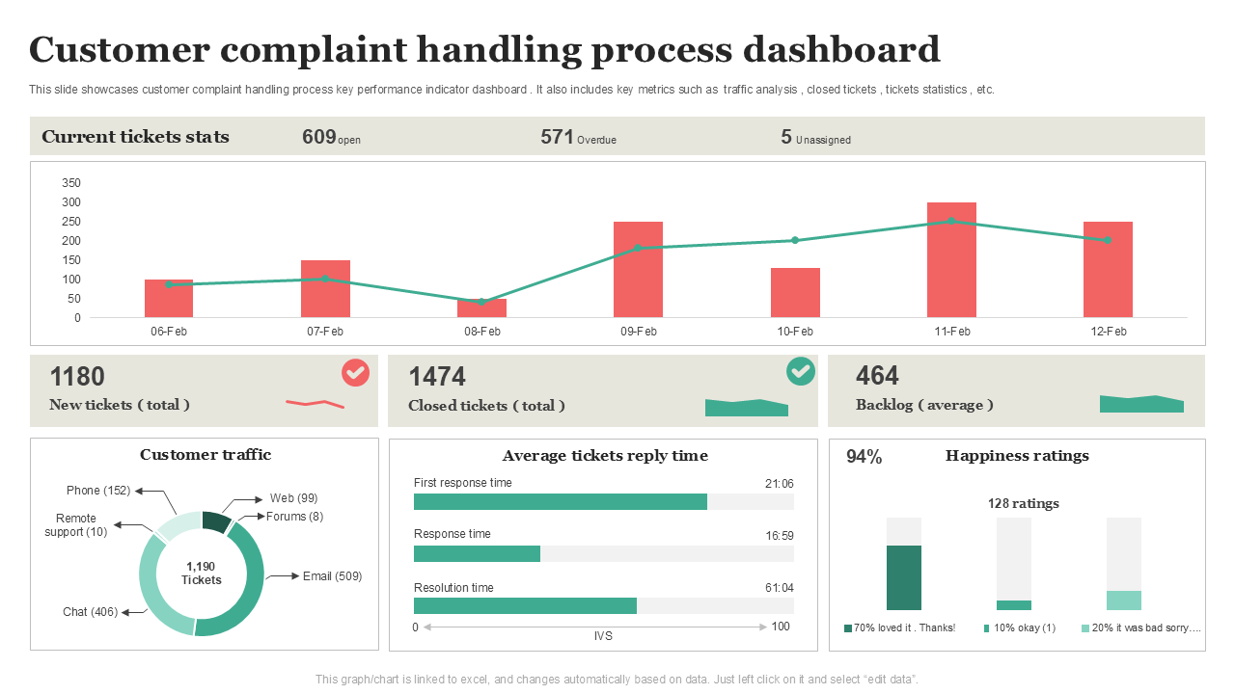
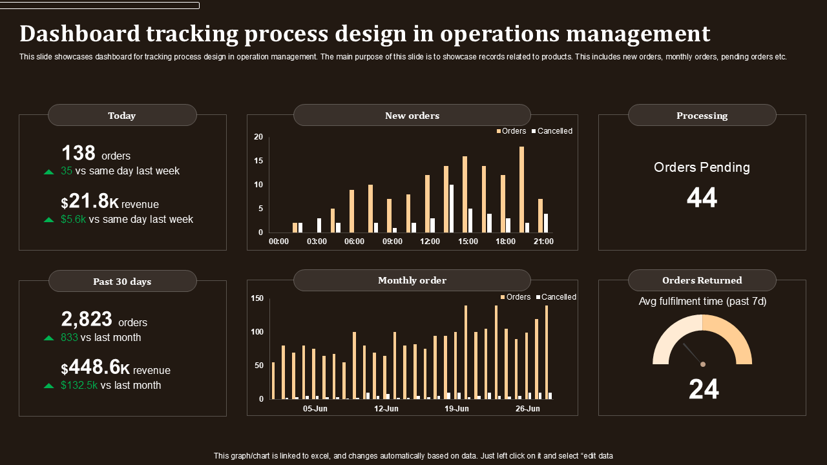
Main Screen: Diagram/Process-Based Style
Workflow Guidance: UI looks like a flowchart of the business process.
Step-by-Step: Directs users through a mandatory sequence (1 -> 2 -> 3).
Status Visualization: Use color to show which steps are "Complete" or "Pending."
Training: Extremely effective for reducing training time for complex industrial software.
Example: Supply chain software showing the flow from "Order" to "Warehouse" to "Shipping."

Slide 40
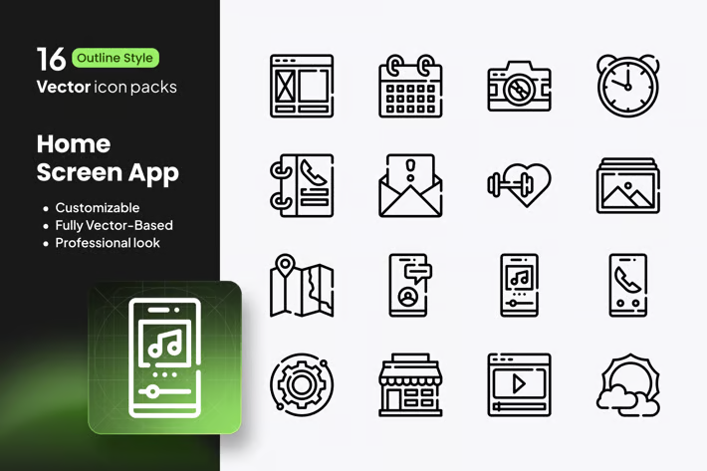
Main Screen: Icon-Based (Tiles)
Visual Metaphors: Icons act as international language shortcuts.
Touch-Friendly: Large tiles are ideal for mobile and tablet interfaces.
Focus: Best for systems with 4-8 primary high-level tasks.
Consistency: Icons must have standard meanings (Home, Gear for Settings).
Industry Case: Windows 11 Start Menu and Mobile App Drawers use this style for high scanability.

Slide 41
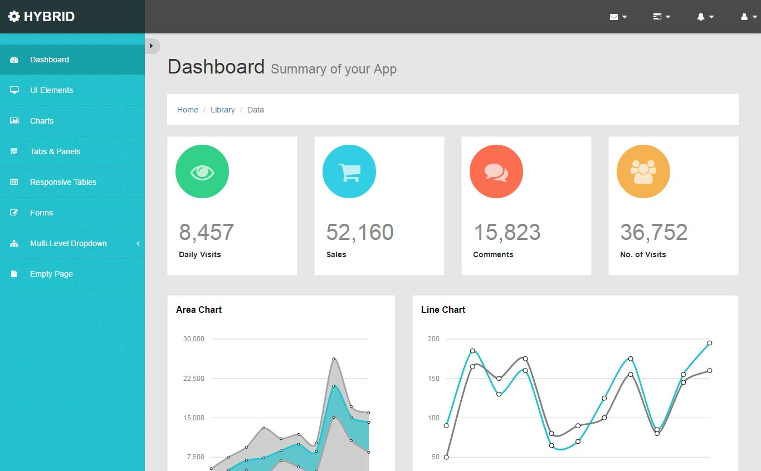
Main Screen: Integrated Hub Style
Combination: Merges Menus, Icons, and Real-time Widgets.
Information Rich: Shows data summaries (Charts) alongside navigation.
Primary & Secondary: Sidebar for navigation + Top bar for user info + Center for dashboard.
Versatility: The modern standard for Enterprise SaaS (e.g., Salesforce, Jira).
Design Goal: Balance the "Signal to Noise" ratio so users aren't overwhelmed by data.

Slide 42
Data Entry Screen - Content
Acts as the primary interface enabling users to digitize real-world recording, tracking, and transactional tasks into the system database.
User-Inputted Data (Direct Input)
Computed Data (Derived Input)
Design Imperative
Values manually entered by the user.
The software must automatically validate these inputs against predefined business constraints to ensure data integrity.
Read-only values calculated and displayed automatically by the system (e.g., age based on date of birth, line-item subtotal) to speed up data entry and minimize cognitive load.
Prioritize data entry efficiency, reduce physical input fatigue, and enforce automated real-time error prevention.

Slide 43
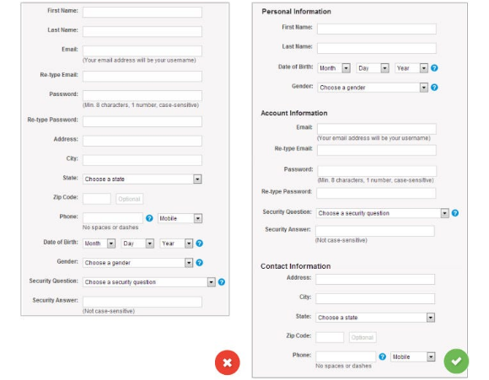
Data Entry Screen – Design Rules
Design Rules
The Golden Rule: Minimize human typing error rates and prevent user fatigue.
Clarity: Labels should be close to input fields to reduce scanning.
Logic: Group related fields (e.g., Address info in one block).
Error Prevention: Use appropriate controls (Dropdowns vs. Text boxes).
Feedback: Provide real-time validation (e.g., green checkmark for valid ID).
Design Rule: Use "Steppers" for very long forms to prevent user fatigue.

Slide 44
Data Entry Screen – User Interactions
Standard Operations
Advanced usability features
Data Mutation: must support three foundational operations:
Save/Commit (persist new or modified records),
Delete (remove or soft-delete data),
Search/Refresh (fetch existing data for modification).
Contextual Feedback:
Providing clear visual cues (color-coded success toasts, modal confirmations for destructive actions like delete) to prevent accidental data loss.
Hotkeys:
Binding crucial actions to keyboard shortcuts (e.g., Ctrl + S to save, Esc to cancel) to allow power-users to navigate without touching the mouse.
Tab-Order & Focus Management:
Ensuring logical, sequential navigation using the Tab key through form inputs, preventing erratic cursor jumping.

Slide 45
Data Input Screen: Layouts
List-Based Layout
Profile-Based Layout
Form-Based Layout
Hybrid Layout
Structured as a continuous tabular matrix or data grid;
Ideal for managing uniform, highly structured entities with few attributes
Examples:
Configuring product categories,
Class rosters
Structured around a singular, highly detailed entity;
Groups broad attribute sets into clean sections or tabs
Examples:
Student profiles,
Employee medical histories.
Mimics real-world paper forms, featuring a master header section linked to multiple line-item detail rows.
Examples:
Sales Invoices,
Purchase Orders.
Blends the above layouts to accommodate complex business workflows.

Slide 46
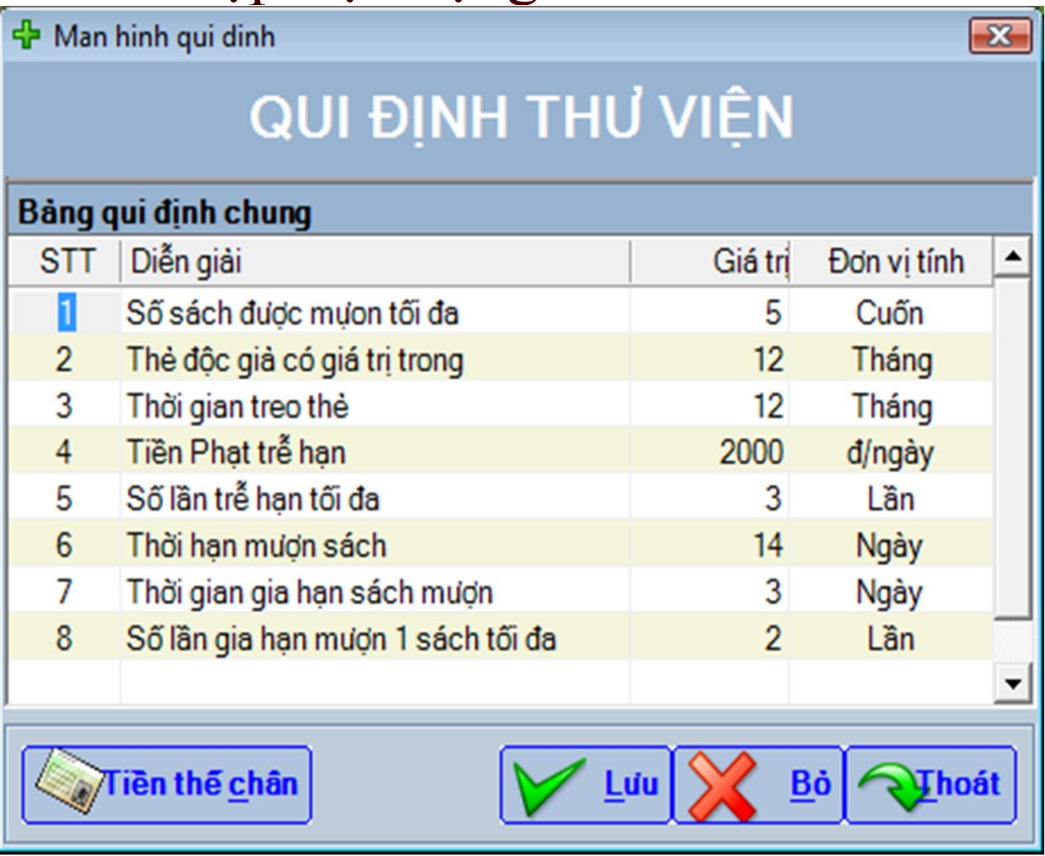
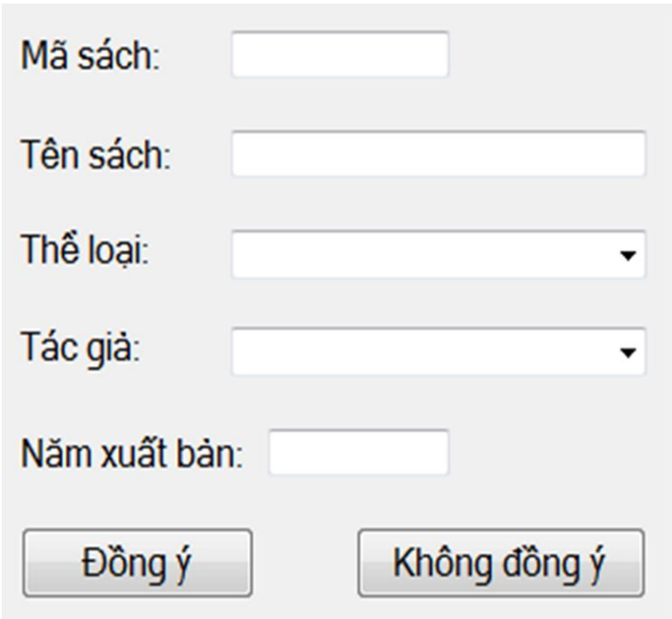
Data Input Screen: List-based & Form-based layout’ examples

Slide 47
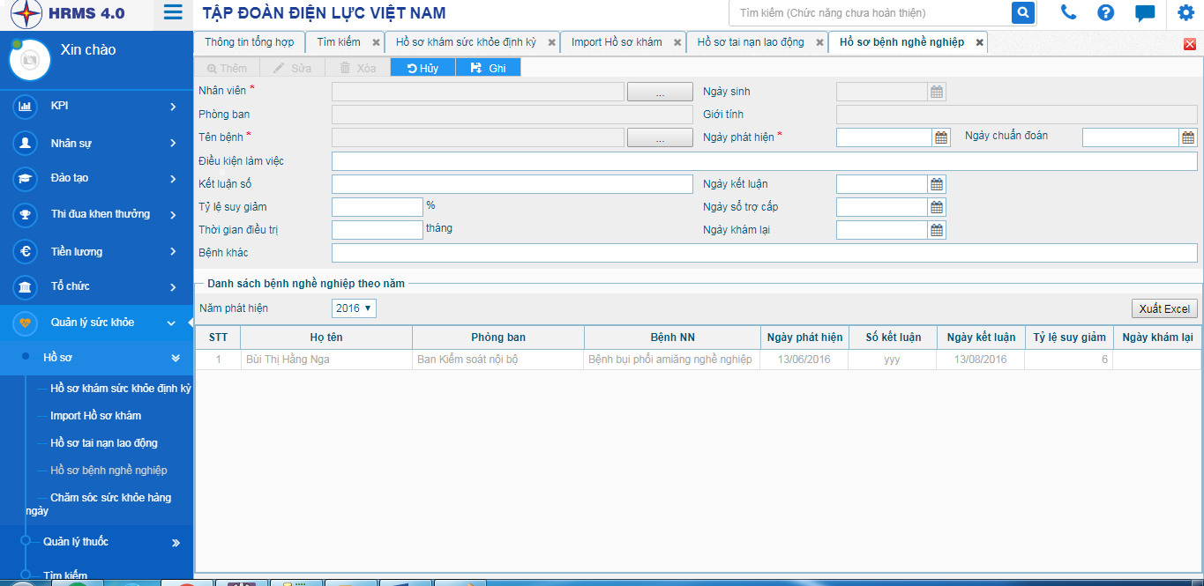
Data Input Screen: Profile-based layout example

Slide 48
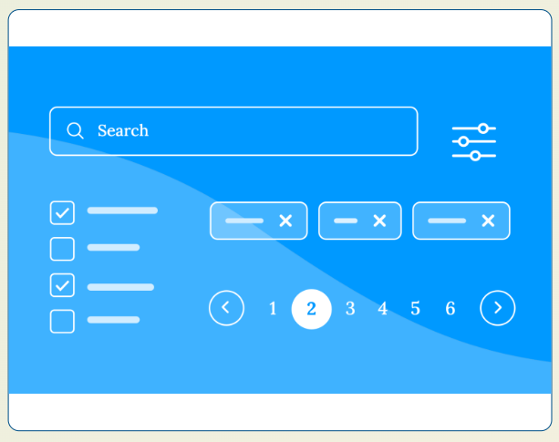
Search & Query Screens
Simplicity: A single, prominent search bar is often better than complex filters.
Helpfulness: Support auto-suggestions and fuzzy matching for typos.
Transparency: Clearly show the results found and the active filters.
"Zero State": Provide helpful feedback if no results are found.
Example: The Spotify search bar updates instantly as you type each letter.

Slide 49
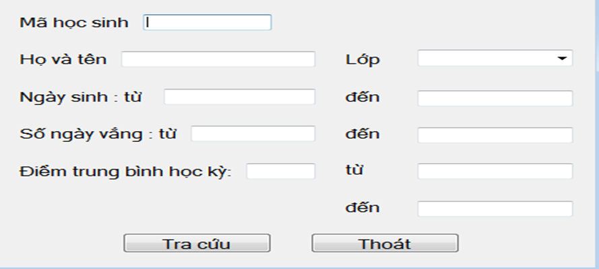
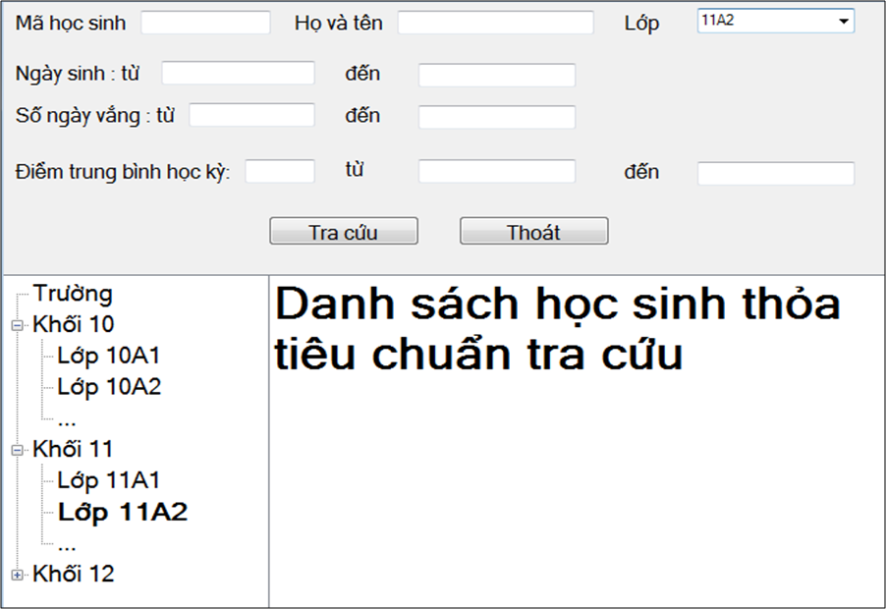
Search & Query Screens
Input Standard Criteria:
Logical Expression Search: Provides combinations of criteria using operators (AND, OR, NOT) via dropdowns.
Tree-Structured Search: Hierarchical drill-downs, allowing users to browse down from categories to specific files.
Integrated Search Form: Offers a single global text bar combined with advanced multi-field filter panels.

Slide 50
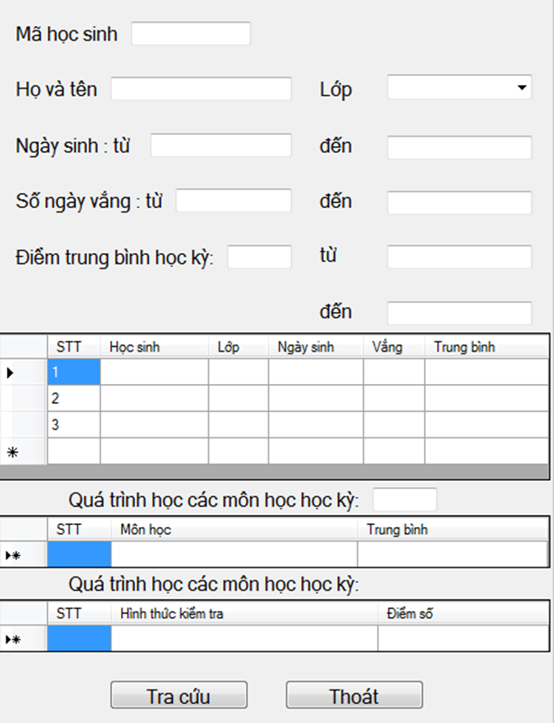
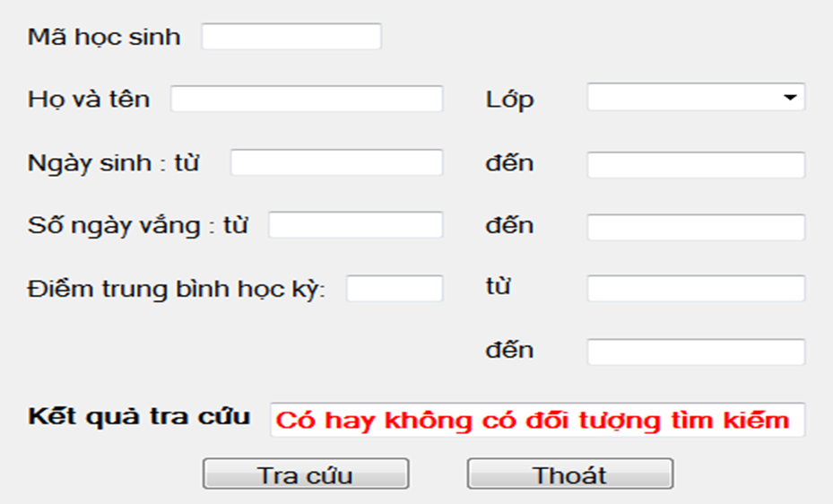
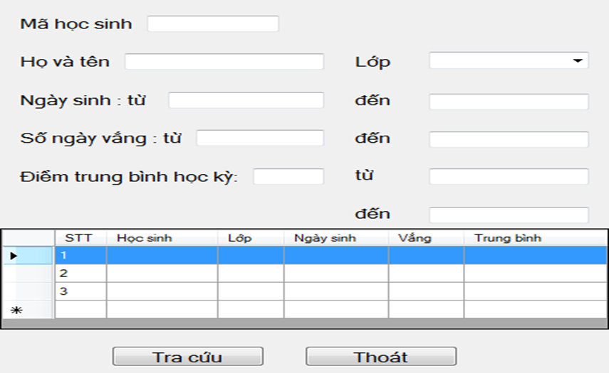
Search & Query Screens
Results Grid Presentation (Phần màn hình kết xuất kết quả):
Notification Alert Style: Displays a brief text message if zero or a singular record matches.
Flat Data Table Grid: Traditional row-and-column data grid with sorting and pagination controls.
Relational Master-Detail List: Selecting a row instantly expands its underlying, linked child datasets.
Hierarchical Tree Grid : Grouped, expandable parent-child structures.

Slide 51
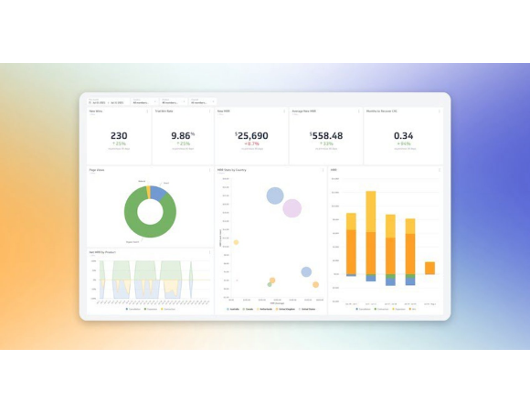
Report & Result Screens
Scannability: Tables should have clear headers and row stripes.
Visualization: Use charts (bar, pie, line) for trend analysis.
Actionable: Reports should allow users to click through to details.
Exportability: Provide options for PDF or Excel versions.
SE Tip: Ensure that the digital report remains readable when printed in grayscale.

Slide 52
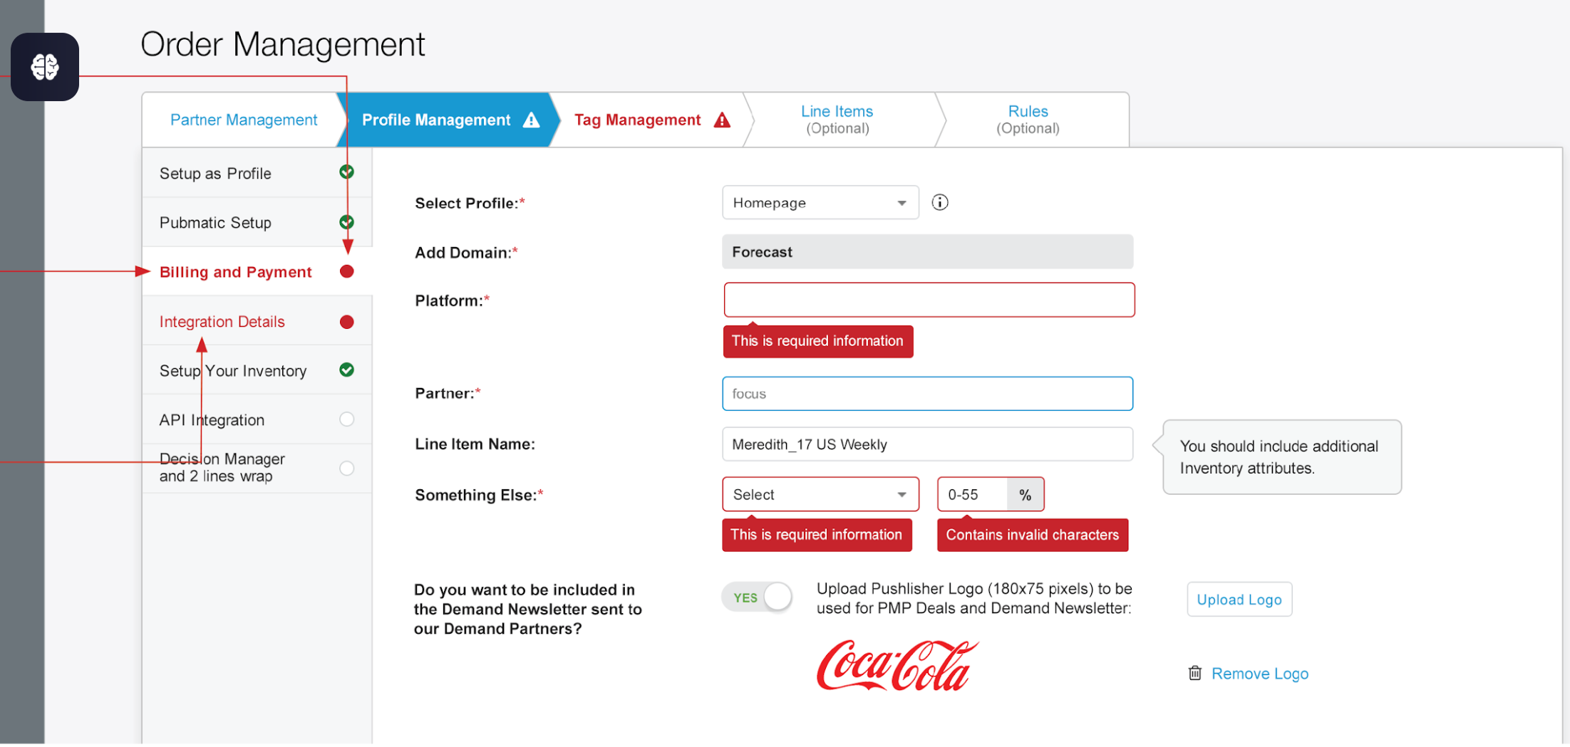
Notifications & Feedback Screen
Attention Levels: High (Errors), Medium (Warnings), Low (Info).
Placement: Use banners for site-wide info; toast alerts for actions.
Icons/Color: Use color semantics consistently (Red=Error, Green=Success).
Dismissibility: Users must be able to dismiss notifications easily.
Good Design: Notifications should not cover up critical navigation elements.

Slide 53
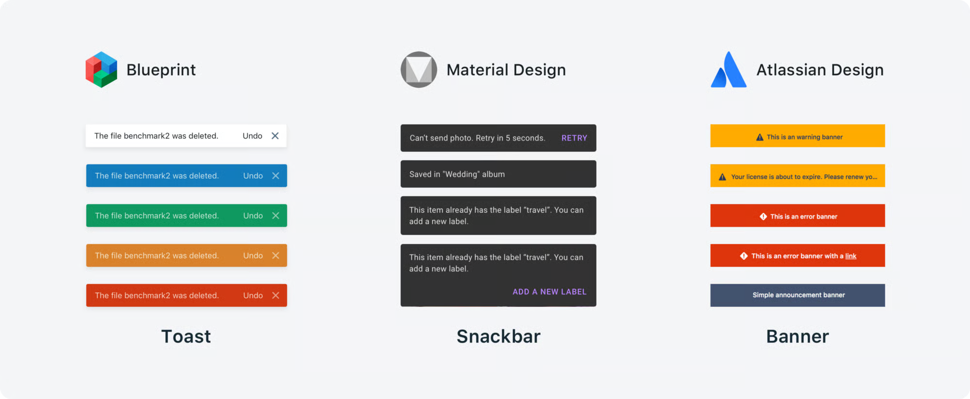
Designing System Notifications
Types: Informational, Success, Warning, Error.
Timing: Show immediately after an action (Feedback).
Non-Intrusive: Use "Toasts" for minor events; "Modals" for critical errors.
Actionable: Provide a way to resolve the problem within the alert.
HCI Rule: Never show an error message without a constructive suggestion on how to fix it.

Slide 54
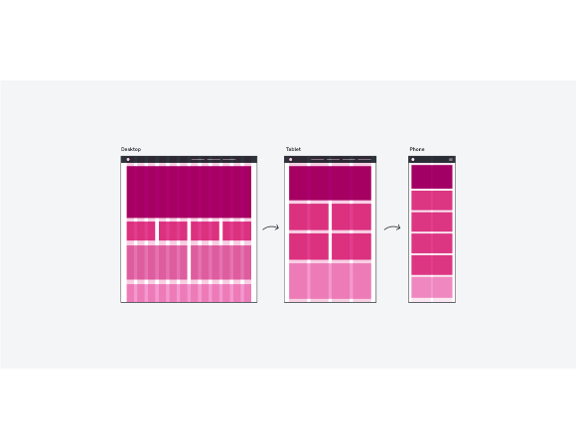
Future Trends in Interaction
•
Responsive Design: Interfaces that adapt perfectly from 4" screens to 40" screens.
•
Dark Mode: Focus on user comfort and energy efficiency.
•
VUI (Voice User Interface): Interacting via language (Siri, Alexa).
•
AI-Driven UI: Interfaces that anticipate user needs based on behavior patterns.
Trend: Skeuomorphism (Real-world look) → Flat Design → Neumorphism (Soft UI).

Slide 55

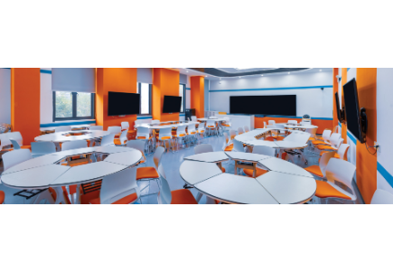
Session 5: Summary
•
ISO 25010: Usability, Reliability, and Performance are linked quality pillars.
•
Nielsen's Heuristics: Use them as a constant compass for usable design.
•
Process Flow: Move from low-fi sketches to high-fi interactive prototypes.
•
Tooling: Leverage modern tools like Figma for design and collaboration.

Slide 56


Core Message
User-centered design is not just about making software look good; it's about ensuring functionality is accessible, efficient, and consistent, ultimately determining the system's quality and success in the real world.
End of Session 5

Slide 57

Questions & Answers

